Slide 1
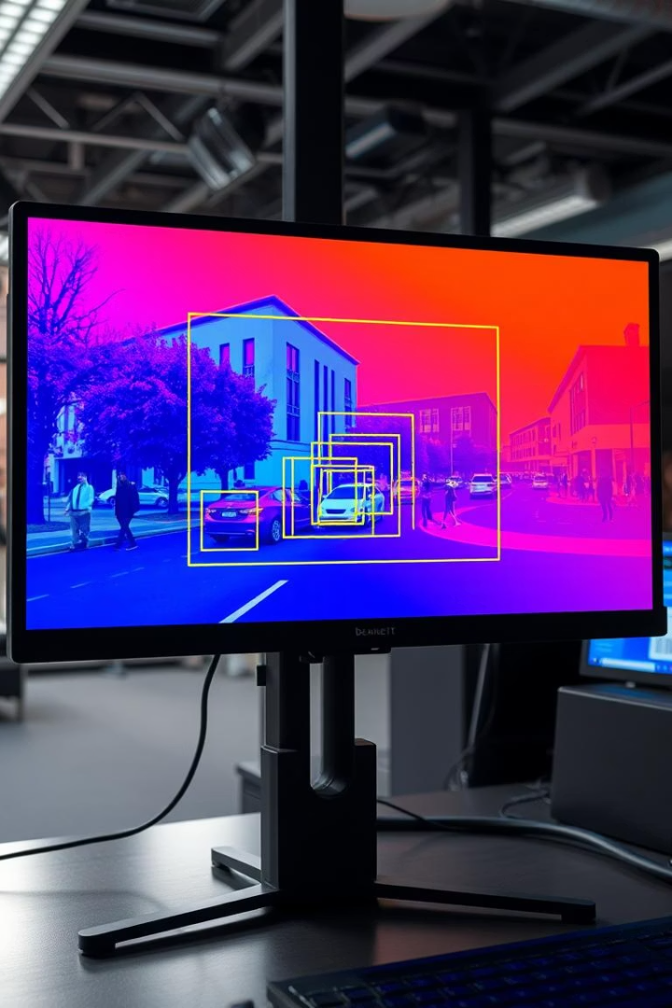
Object Detection: A Computer Vision Project
Welcome to our presentation on Object Detection, a key area in computer vision that involves identifying and locating objects within images or videos. This project was developed by Lakshay Gupta, Yash Verma, and Anshuman Mathur under the guidance of Dr. Yajnaseni Dash at Bennett University.
Our system uses deep learning models such as CNN, SVM, and SVM+MobileNet to process visual data, draw bounding boxes around detected objects, and label them accordingly. Join us as we explore the capabilities of object detection models through practical implementation.

Slide 2
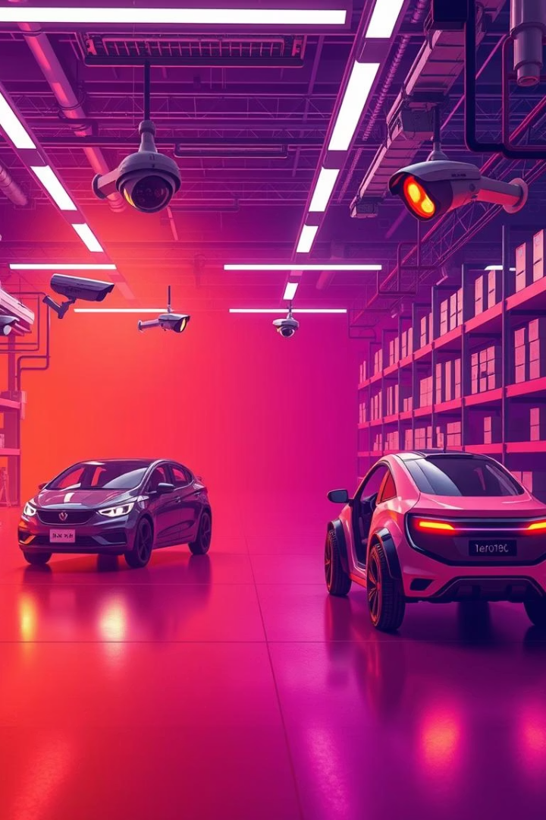



Project Objectives and Applications
Build a Reliable Detection Model
Real-world Applications
Create an efficient object detection system using traditional ML techniques capable of identifying objects with high accuracy
Develop a robust solution applicable to diverse scenarios such as security surveillance, autonomous vehicles, and inventory management
Explore Deep Learning Capabilities
Investigate the effectiveness of various models including CNN, SVM, and hybrid approaches for object detection tasks

Slide 3
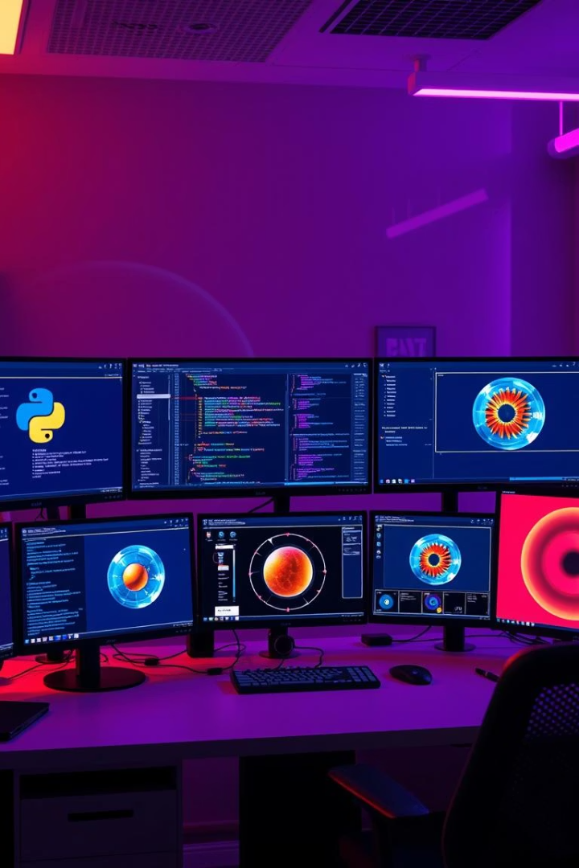




Tools and Technologies
Python
Libraries
ML Models
Primary programming language used for implementation and model development
cv2, scikit-learn, PIL, numpy, flask, tensorflow, os, joblib for data processing and model building
CNN, SVM (poly), and SVM+MobileNet for object detection and classification tasks
Deployment
Flask for backend development and HTML for creating a user-friendly interface

Slide 4
Data Collection and Preprocessing
CIFAR-10 Dataset
Preprocessing Techniques
We utilized the CIFAR-10 dataset from the University of Toronto, which contains images divided into 10 distinct categories, creating a balanced and diverse dataset suitable for image classification.
Resizing images to uniform dimensions
Normalizing pixel values
Formatting labels for training
Data augmentation (flipping, rotation)
This comprehensive dataset provided the foundation for training our models to recognize various objects accurately.
These techniques improved model robustness and helped extract meaningful features from raw image data.

Slide 5






Model Development
CNN
Deep learning model for pattern recognition
SVM (Polynomial Kernel)
For non-linearly separable data classification
MobileNetV2 + SVM (RBF)
Hybrid approach combining efficient feature extraction with strong classification
Our approach involved experimenting with multiple models to identify the most effective solution. The CNN provided consistent accuracy, while the hybrid MobileNetV2 + SVM approach offered a balance between efficiency and performance.

Slide 6
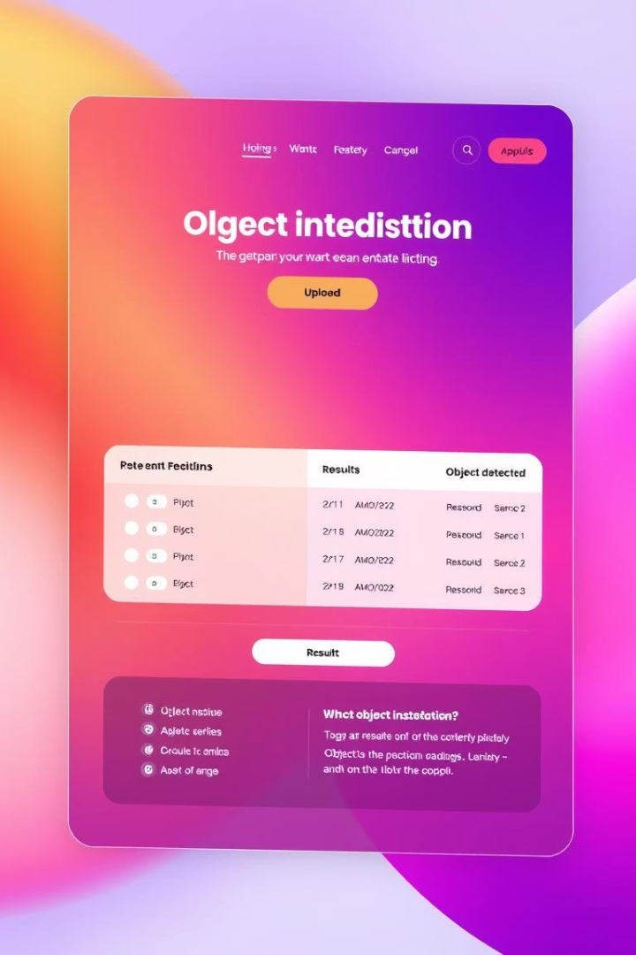
Deployment and User Experience
Flask Backend Development
We built a robust backend using Flask to load the trained model, handle user inputs, process them efficiently, and return accurate predictions.
HTML Frontend Creation
A simple yet effective frontend was designed using HTML, allowing users to easily upload images and view detection results in an intuitive interface.
Integration and Testing
The system was thoroughly tested to ensure seamless interaction between frontend and backend components, providing a smooth user experience even for non-technical users.

Slide 7
Challenges and Results
Challenges Faced
Performance Metrics
User Experience
Overfitting in SVM(RBF) + MobileNetV2
CNN: Highest consistent accuracy
Interactive Flask interface
Understandable for non-technical users
Low testing accuracy in SVM(poly) model
SVM: Faster but less accurate
Evaluated using accuracy and validation graphs
Efficient real-time detection capabilities
Balancing model complexity with performance

Slide 8
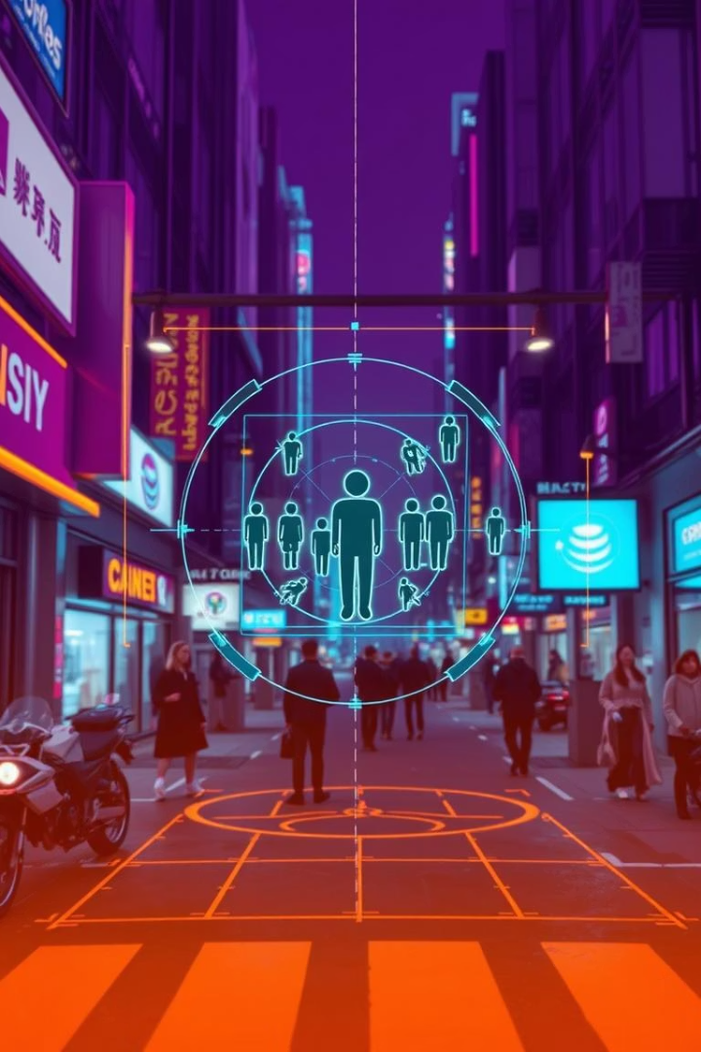
Learnings and Future Scope
1
Key Learnings
Gained in-depth understanding of feature extraction techniques, traditional ML algorithms, and collaborative coding practices. Developed problem-solving skills through continuous model improvement based on test results.
2
Conclusions
The project demonstrated that deep learning approaches, when paired with powerful feature extraction techniques, can deliver reliable results in object classification domains. CNN outperformed other models in terms of consistency and accuracy.
3
Future Scope
Improve speed using quantization and pruning, expand the dataset with more real-world objects, and extend the project to handle multiple object detection from complex scenes.

